Slide 1




Heaps and Priority Queues
Heap Implementations
Advanced Tree Structures
SoftUni Team
Technical Trainers
Software University
http://softuni.bg

Slide 2

Table of Contents
Priority Queue
PQ Basic Implementation
Heaps and Binary Heaps
Insert → Heapify Up
Delete → Heapify Down
Heap Sort
A* Algorithm

Slide 3
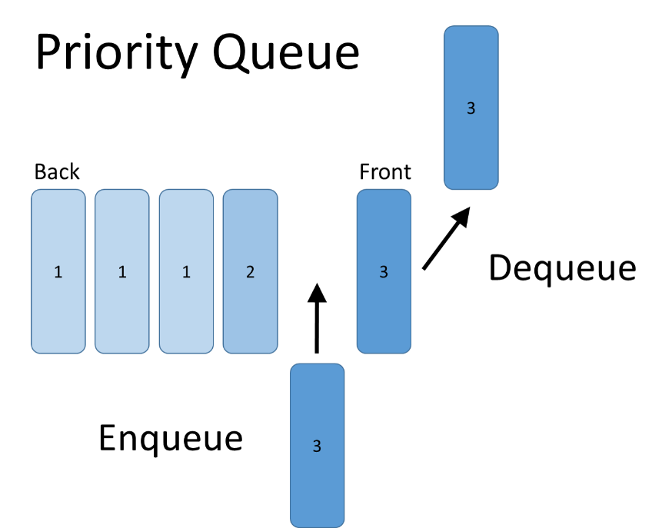
Priority Queue
Dequeue Most Significant Element

Slide 4
Priority Queue
Retains a specific order to the elements
Higher priority elements are pushed to the beginning of the queue
Lower priority elements are pushed to the end of the queue
A
B

Slide 5
Priority Queue
Priority queue abstract data type (ADT) supports:
Insert(element)
Pull() → max/min element
Peek() → max/min element
Where element has a priority

Slide 6
Priority
In C# and Java usually the priority is passed as comparator
E.g. IComparable<T> in C# and Comparable<T> in Java
class PriorityQueue<T> where T : IComparable<T>
{
…
}
class PriorityQueue<T extends Comparable<T>> {
…
}

Slide 7
Priority Queue – Complexity Goal
Unsorted Resizing Array
ex.
Sorted Resizing Array
ex.
2 | 4 | 1 | 3 | 5
1 | 2 | 3 | 4 | 5
 | Insert | Pull | Peek
Unsorted Array
Sorted Array
Goal
O(1)
O(N)
O(N)
O(N)
O(1)
O(1)
O(logN)
O(logN)
O(logN)

Slide 8
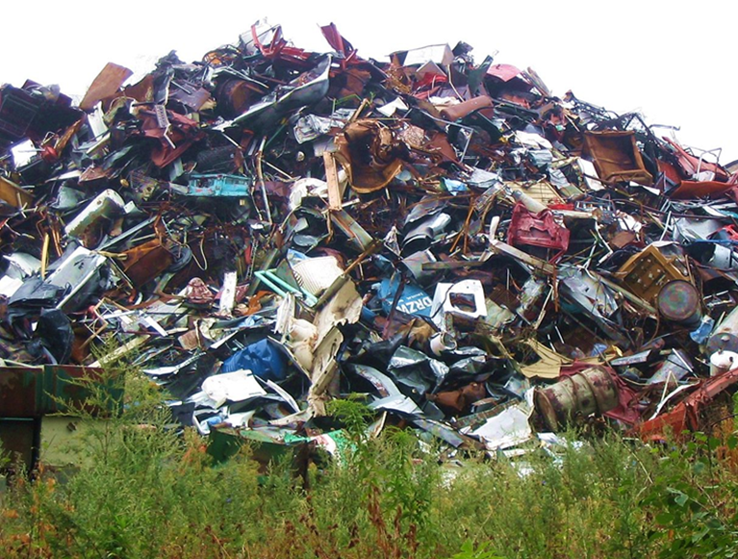
Heaps
Heap, Binary Heap

Slide 9
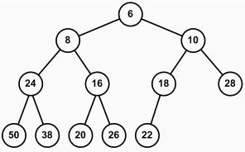
What is Heap?
Heap
Tree-based data structure
Stored in an array
Heaps hold the heap property for each node:
Min Heap
parent ≤ children
Max Heap
parent ≥ children

Slide 10
Binary Heap
Binary heap
Represents a Binary Tree
Shape property - Binary heap is a complete binary tree:
Every level, except the last, is completely filled
Last is filled from left to right
5
4
1
3
2
0 | 1 | 2 | 3 | 4
5
4
1
3
2

Slide 11
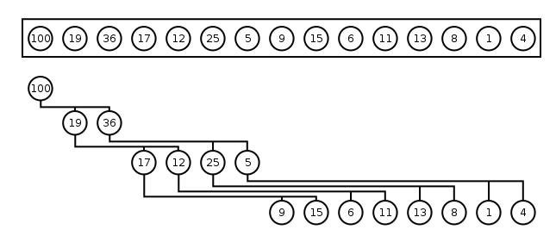
Binary Heap – Array Implementation
Binary heap can be efficiently stored in an array
Parent(i) = (i - 1) / 2
Left(i) = 2 * i + 1; Right(i) = 2 * i + 2
0 | 1 | 2 | 3 | 4 | 5 | 6 | 7 | 8 | 9 | 10 | 11 | 12 | 13 | 14
heap and shape properties are satisfied

Slide 12
Heap Insertion
To preserve heap properties:
Insert at the end
Heapify element up
Right: Max Heap
Insert 16
Insert 25
17
Satisfy heap property
Promote while element > parent
9
15
6
5
8
16
25

Slide 13
Problem: Heap Insert and Peek
Implement a max BinaryHeap<T> with:
int Count
void Insert(T item) – O(logN)
T Peek() – O(1)
25
17
17
15
25
9
15
9
5
8
16
6
5
8
16
6

Slide 14
Solution: Heap Insert and Peek (2)
public class BinaryHeap<T> where T : IComparable<T>
{
// TODO: create "List<T> heap" to store elements
public void Insert(T item)
{
this.heap.Add(item);
this.HeapifyUp(this.heap.Count - 1);
}
// TODO: Implement Peek()
}

Slide 15
Solution: Heap Insertion and Peek (3)
private void HeapifyUp(int current)
{
while (current > 0 &&
IsLess(((current - 1) / 2), current))
{
this.Swap(current, (current - 1) / 2);
current = (current - 1) / 2;
}
}
// TODO: Implement IsLess() and Swap()

Slide 16
Heap Deletion
To preserve heap properties:
Save first element
Swap first with last
Heapify first down
Return element
Right: Max Heap
Pull – returns 25
25
Demote while element < greater child
25
17
16
9
5
8
15
6

Slide 17
Problem: Heap Deletion
Using your Max BinaryHeap<T> implement:
T Pull() – O(logN) – throws Invalid Operation ex.
17
16
9
15
9
15
6
5
8
16
6
5
8

Slide 18
Solution: Heap Deletion
public T Pull()
{
//TODO: check if heap is empty
T item = this.heap[0];
this.Swap(0, this.heap.Count() - 1);
this.heap.RemoveAt(this.heap.Count() - 1);
this.HeapifyDown(0);
return item;
}

Slide 19
Solution: Heap Deletion (2)
private void HeapifyDown(int current)
{
while (current < this.heap.Count / 2)
{
int child = 2 * current + 1;
if (HasRight(child) && IsLess(child, child + 1))
{
child = child + 1;
}
if (!IsLess(current, child)) break;
this.Swap(current, child);
current = child;
}
}
Check if right child is larger
Break if element is in place

Slide 20

Binary Heap
Live Exercises in Class (Lab)

Slide 21
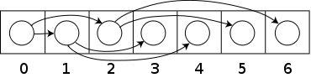
Heap Sort
Heap Construction and Sorting

Slide 22
Heap Construction from Array
To construct a heap:
Heapify Down from i = N/2 to 0
2
Heap with 1 element
Heap with 3 elements
4
1
3
5
2
4
1
3
5
0 | 1 | 2 | 3 | 4

Slide 23
Heap Sort
To sort an array:
Construct heap
From i = N - 1 to 1
Swap a[0] with a[i]
Heapify down a[0] to i - 1
5
4
1
3
2
5
4
1
3
2
0 | 1 | 2 | 3 | 4

Slide 24
Problem: Heap Sort
Create a static class Heap<T> with:
static void Sort(T[] arr) – O(NlogN)
Hints:
Use Heap Construction and HeapifyDown
8 | 5 | 7 | 1 | 3 | 2
1 | 2 | 3 | 5 | 7 | 8

Slide 25
Solution: Heap Sort
public static class Heap<T> where T : IComparable<T>
{
public static void Sort(T[] arr)
{
for (int i = arr.Length / 2; i >= 0; i--)
// TODO: Heapify Down
for (int i = arr.Length - 1; i > 0; i--)
{
Swap(0, i, arr);
// TODO: Heapify Down
}
}
}

Slide 26
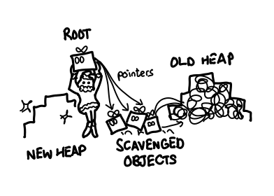
Other Heap Data Structures
Binomial heap
Fibonacci heap
Pairing heap
Treap
Skew heap
Soft heap
…

Slide 27
Heap Sort
Live Exercises in Class (Lab)

Slide 28
A* (A Star)
The A* pathfinding algorithm is a modification of Dijkstra's shortest path algorithm
At each step it uses a heuristic function to guide its search
GCost – the distance from current to the start
HCost – the distance from current to the destination
Traverses the nodes with lowest f-cost first
Updates the f-costs of their neighbors
FCost = GCost + HCost

Slide 29
A* Shortest Path: Step #1
Start traversal by putting A in priority queue
 | 0 | 1 | 2 | 3 | 4 | 5 | 6 | 7 | 8 | 9 | 10
0
1 |  |  |  |  | B
2
3
4 |  |  |  |  |  |  |  | A
5

Slide 30
A* Shortest Path: Step #2
Enqueue all non-visited adjacent cells
 | 0 | 1 | 2 | 3 | 4 | 5 | 6 | 7 | 8 | 9 | 10
0
1 |  |  |  |  | B
2
3
4 |  |  |  |  |  |  |  | A
5
g-cost
h-cost
14 28
14
28
10
38
14
48
42
48
62
42
10
38
10
52
48
62
14
48
10
52
14
56
f-cost
62
62
70

Slide 31
A* Shortest Path: Step #3
Visit the cell with lowest f-cost of 42 (cell 3, 6)
Enqueue non-visited adjacent cells
 | 0 | 1 | 2 | 3 | 4 | 5 | 6 | 7 | 8 | 9 | 10
0
1 |  |  |  |  | B
2
3
4 |  |  |  |  |  |  |  | A
5
24
24
14
28
10
38
14
48
48
42
48
62
28
34
10
38
10
52
62
48
62
14
48
10
52
14
56
62
62
70

Slide 32
A* Shortest Path: Step #4
There are several nodes with the lowest f-cost 48
Choose the one with lowest h-cost (cell 3,5)
 | 0 | 1 | 2 | 3 | 4 | 5 | 6 | 7 | 8 | 9 | 10
0
1 |  |  |  |  | B
2
3
4 |  |  |  |  |  |  |  | A
5
34
20
24
24
14
28
10
38
14
48
54
48
42
48
62
38
30
28
34
10
38
10
52
68
62
48
62
14
48
10
52
14
56
62
62
70

Slide 33
A* Shortest Path: Step #5
Visit cell 3,7
 | 0 | 1 | 2 | 3 | 4 | 5 | 6 | 7 | 8 | 9 | 10
0
1 |  |  |  |  | B
2
3
4 |  |  |  |  |  |  |  | A
5
24
44
68
34
20
24
24
14
28
10
38
14
48
54
48
42
48
62
38
30
28
34
10
38
10
52
68
62
48
62
14
48
10
52
14
56
62
62
70

Slide 34
A* Shortest Path: Step #6
Visit cell 4,6
Update the g-cost of its adjacent cell 4,5
We just found a shorter path from start to that cell
 | 0 | 1 | 2 | 3 | 4 | 5 | 6 | 7 | 8 | 9 | 10
0
1 |  |  |  |  | B
2
3
4 |  |  |  |  |  |  |  | A
5
24
44
68
34
20
24
24
14
28
10
38
14
48
54
48
42
48
62
38
30
20
34
10
38
10
52
68
54
48
62
24
44
14
48
10
52
14
56
68
62
62
70

Slide 35
A* Shortest Path: Step #7
Visit cell 3,4
 | 0 | 1 | 2 | 3 | 4 | 5 | 6 | 7 | 8 | 9 | 10
0
1 |  |  |  |  | B
2
3
4 |  |  |  |  |  |  |  | A
5
24
44
68
44
24
34
20
24
24
14
28
10
38
14
48
68
54
48
42
48
62
48
34
38
30
20
34
10
38
10
52
82
68
54
48
62
24
44
14
48
10
52
14
56
68
62
62
70

Slide 36
A* Shortest Path: Step #8
Visit cell 4,5
Update g-cost of adjacent cell 4,4
 | 0 | 1 | 2 | 3 | 4 | 5 | 6 | 7 | 8 | 9 | 10
0
1 |  |  |  |  | B
2
3
4 |  |  |  |  |  |  |  | A
5
24
44
68
44
24
34
20
24
24
14
28
10
38
14
48
68
54
48
42
48
62
48
34
30
30
20
34
10
38
10
52
82
60
54
48
62
34
40
24
44
14
48
10
52
14
56
74
68
62
62
70

Slide 37
A* Shortest Path: Step #9
Visit cell 4,4
 | 0 | 1 | 2 | 3 | 4 | 5 | 6 | 7 | 8 | 9 | 10
0
1 |  |  |  |  | B
2
3
4 |  |  |  |  |  |  |  | A
5
24
44
68
44
24
34
20
24
24
14
28
10
38
14
48
68
54
48
42
48
62
40
34
30
30
20
34
10
38
10
52
74
60
54
48
62
44
44
34
40
24
44
14
48
10
52
14
56
88
74
68
62
62
70

Slide 38
A* Shortest Path: Step #10
Visit cell 3,8
 | 0 | 1 | 2 | 3 | 4 | 5 | 6 | 7 | 8 | 9 | 10
0
1 |  |  |  |  | B
2
3
4 |  |  |  |  |  |  |  | A
5
24
44
28
54
68
82
44
24
34
20
24
24
14
28
10
38
14
48
24
58
68
54
48
42
48
62
82
40
34
30
30
20
34
10
38
10
52
28
62
74
60
54
48
62
90
44
44
34
40
24
44
14
48
10
52
14
56
88
74
68
62
62
70

Slide 39
A* Shortest Path: Step #11
Visit cell 5,6
 | 0 | 1 | 2 | 3 | 4 | 5 | 6 | 7 | 8 | 9 | 10
0
1 |  |  |  |  | B
2
3
4 |  |  |  |  |  |  |  | A
5
24
44
28
54
68
82
44
24
34
20
24
24
14
28
10
38
14
48
24
58
68
54
48
42
48
62
82
40
34
30
30
20
34
10
38
10
52
28
62
74
60
54
48
62
90
44
44
34
40
24
44
14
48
10
52
14
56
88
74
68
62
62
70

Slide 40
A* Shortest Path: Step #12
Visit cell 5,7
 | 0 | 1 | 2 | 3 | 4 | 5 | 6 | 7 | 8 | 9 | 10
0
1 |  |  |  |  | B
2
3
4 |  |  |  |  |  |  |  | A
5
24
44
28
54
68
82
44
24
34
20
24
24
14
28
10
38
14
48
24
58
68
54
48
42
48
62
82
40
34
30
30
20
34
10
38
10
52
28
62
74
60
54
48
62
90
44
44
34
40
24
44
14
48
10
52
14
56
88
74
68
62
62
70

Slide 41
A* Shortest Path: Step #13
Visit cell 4,8
Update g-cost of adjacent cell 4,9
 | 0 | 1 | 2 | 3 | 4 | 5 | 6 | 7 | 8 | 9 | 10
0
1 |  |  |  |  | B
2
3
4 |  |  |  |  |  |  |  | A
5
24
44
28
54
68
82
44
24
34
20
24
24
14
28
10
38
14
48
24
58
68
54
48
42
48
62
82
40
34
30
30
20
34
10
38
10
52
20
62
74
60
54
48
62
82
44
44
34
40
24
44
14
48
10
52
14
56
24
66
88
74
68
62
62
70
90

Slide 42
A* Shortest Path: Step #13
Visit cell 4,8
Update g-cost of adjacent cell 4,9
 | 0 | 1 | 2 | 3 | 4 | 5 | 6 | 7 | 8 | 9 | 10
0
1 |  |  |  |  | B
2
3
4 |  |  |  |  |  |  |  | A
5
64
24
24
44
28
54
88
68
82
54
28
44
24
34
20
24
24
14
28
10
38
14
48
24
58
82
68
54
48
42
48
62
82
64
38
40
34
30
30
20
34
10
38
10
52
20
62
102
74
60
54
48
62
82
44
44
34
40
24
44
14
48
10
52
14
56
24
66
88
74
68
62
62
70
90

Slide 43
A* Shortest Path: Step #14
Visit cell 2,8
 | 0 | 1 | 2 | 3 | 4 | 5 | 6 | 7 | 8 | 9 | 10
0
1 |  |  |  |  | B
2
3
4 |  |  |  |  |  |  |  | A
5
38
30
34
40
38
50
68
74
88
64
24
24
44
28
54
88
68
82
54
28
44
24
34
20
24
24
14
28
10
38
14
48
24
58
82
68
54
48
42
48
62
82
64
38
40
34
30
30
20
34
10
38
10
52
20
62
102
74
60
54
48
62
82
44
44
34
40
24
44
14
48
10
52
14
56
24
66
88
74
68
62
62
70
90

Slide 44
A* Shortest Path: Step #15
Visit cell 1,7
 | 0 | 1 | 2 | 3 | 4 | 5 | 6 | 7 | 8 | 9 | 10
0
1 |  |  |  |  | B
2
3
4 |  |  |  |  |  |  |  | A
5
52
24
48
34
52
44
76
82
96
48
20
38
30
34
40
38
50
68
68
74
88
64
24
24
44
28
54
88
68
82
54
28
44
24
34
20
24
24
14
28
10
38
14
48
24
58
82
68
54
48
42
48
62
82
64
38
40
34
30
30
20
34
10
38
10
52
20
62
102
74
60
54
48
62
82
44
44
34
40
24
44
14
48
10
52
14
56
24
66
88
74
68
62
62
70
90

Slide 45
A* Shortest Path: Step #16
Visit cell 1,6
 | 0 | 1 | 2 | 3 | 4 | 5 | 6 | 7 | 8 | 9 | 10
0
1 |  |  |  |  | B
2
3
4 |  |  |  |  |  |  |  | A
5
62
14
52
24
48
34
52
44
76
76
82
96
58
10
48
20
38
30
34
40
38
50
68
68
68
74
88
64
24
24
44
28
54
88
68
82
54
28
44
24
34
20
24
24
14
28
10
38
14
48
24
58
82
68
54
48
42
48
62
82
64
38
40
34
30
30
20
34
10
38
10
52
20
62
102
74
60
54
48
62
82
44
44
34
40
24
44
14
48
10
52
14
56
24
66
88
74
68
62
62
70
90

Slide 46
A* Shortest Path: Step #17
Visit cell 1,5
Found our destination cell → over
 | 0 | 1 | 2 | 3 | 4 | 5 | 6 | 7 | 8 | 9 | 10
0
1 |  |  |  |  | B
2
3
4 |  |  |  |  |  |  |  | A
5
62
14
52
24
48
34
52
44
76
76
82
96
58
10
48
20
38
30
34
40
38
50
68
68
68
74
88
64
24
24
44
28
54
88
68
82
54
28
44
24
34
20
24
24
14
28
10
38
14
48
24
58
82
68
54
48
42
48
62
82
64
38
40
34
30
30
20
34
10
38
10
52
20
62
102
74
60
54
48
62
82
44
44
34
40
24
44
14
48
10
52
14
56
24
66
88
74
68
62
62
70
90

Slide 47





A* Shortest Path: Reconstruction
If we have a prev[] array and keep at each cell where we came from, we can reconstruct the path
58
10
48
20
38
30
68
68
68
24
44
68
10
38
48

Slide 48
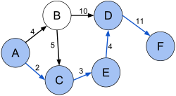
Priority Queue Applications
Data Compression
Graph Shortest Path / GPS
Pathfinding / AI
Many others

Slide 49

Summary
Heaps are used to implement priority queues
Binary Heaps have tree-like structure
Stored in arrays
Efficient operations
Add
Find min / max
Remove min / max
Priority Queues have wide application

Slide 50







Heaps and Priority Queues
https://softuni.bg/opencourses/data-structures

Slide 51
License
This course (slides, examples, demos, videos, homework, etc.) is licensed under the "Creative Commons Attribution-NonCommercial-ShareAlike 4.0 International" license

Slide 52





Trainings @ Software University (SoftUni)
Software University – High-Quality Education, Profession and Job for Software Developers
softuni.bg
Software University Foundation
softuni.org
Software University @ Facebook
facebook.com/SoftwareUniversity
Software University Forums
forum.softuni.bg

